Slide 1

Midterm Presentation Lecture Computer Vision WS 20/21 Bottle Cap Detection by Localizing Regions of Interest
Janelle Pfeifer
Matr.Nr: 9030898
Notes:
Hello My Name is Janelle Pfeifer
Hold a Midterm Presentation
Bottel Cap Detection Project of Computer Vision Lecture

Slide 2

Structure
Topic
Sub Steps
Data
Approach
Intermediate results
Future Steps
Evaluation
Timetable
Notes:
The structure in which I will be Presenting
Introduce the Projekt
Show you my Approach
Talk about future plans

Slide 3
Introduction - Topic
Find positions of bottle caps in videos
Annotate caps in frames
Seperate caps from distractors
Distinguish states: face-up, face-down, deformed
Notes:
Topic of the Project is to
Find bottle caps in a static szene of a video
Bottle Caps get added and removed from the during the video
There is one static szene in which the caps lie stil.
The goal is to annotate the caps in a frame of that scene
Only a part of the Frame is relevant.
Bottle Caps distinguished from distractor objects and
Determine state of the cap itself

Slide 4
Introduction – sub steps
Find static scene in Video
Choose frame
Find cap-container within the frame
Isolate Regions of Interest inside the container
Determine what kind of content the regions show
-> cap face up, face down, deformed, distractor
Notes:
1,5 – 2,25 Minuten
Taks can be broken down into sub steps

Slide 5
Material - Data
Mp4 Videos, 10-20 seconds long, 25 fps
Show empty rectangular container
Bottle caps and distractor objects added
Show static shot of caps and container
Caps possibly get removed
Stil Frames of Videos and JSON Files that annotate Positions of caps
Notes:
7,5 – 10,5 Min
Description of setup and your data
Assumptions and prerequisites
Approaches you already have or are going to apply incl. motivation

Slide 6
Assumptions
Videos follow the guidelines
Bottle caps face down, white
Bottle caps face up colorful
Face up and face down are circular
Can be distinguished by a neural network

Slide 7
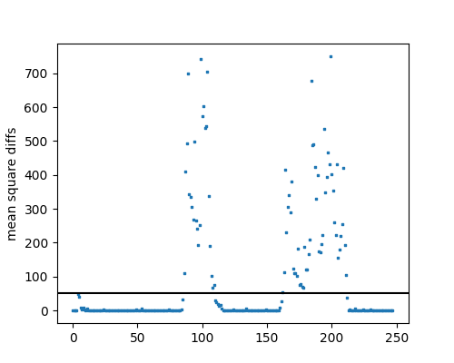
Approach – Static Scene
Find Static Scene in Video
Calculate mean square error between frames
Cut into sequences with a threshold
Ignore sequence that starts with frame 0
Choose the best two sequences
Of those choose the sequence that starts the earliest
mse for video 129
threshhold at 50
Notes:
Finding static scene
Static scene differences between frames are small
Videos have up to three static seqzences
One at the start, one after bottlecaps are added
One after they are removed
Quantify differences between frames with mean square error
Cut video into seqzences where difference stays below threshold

Slide 8
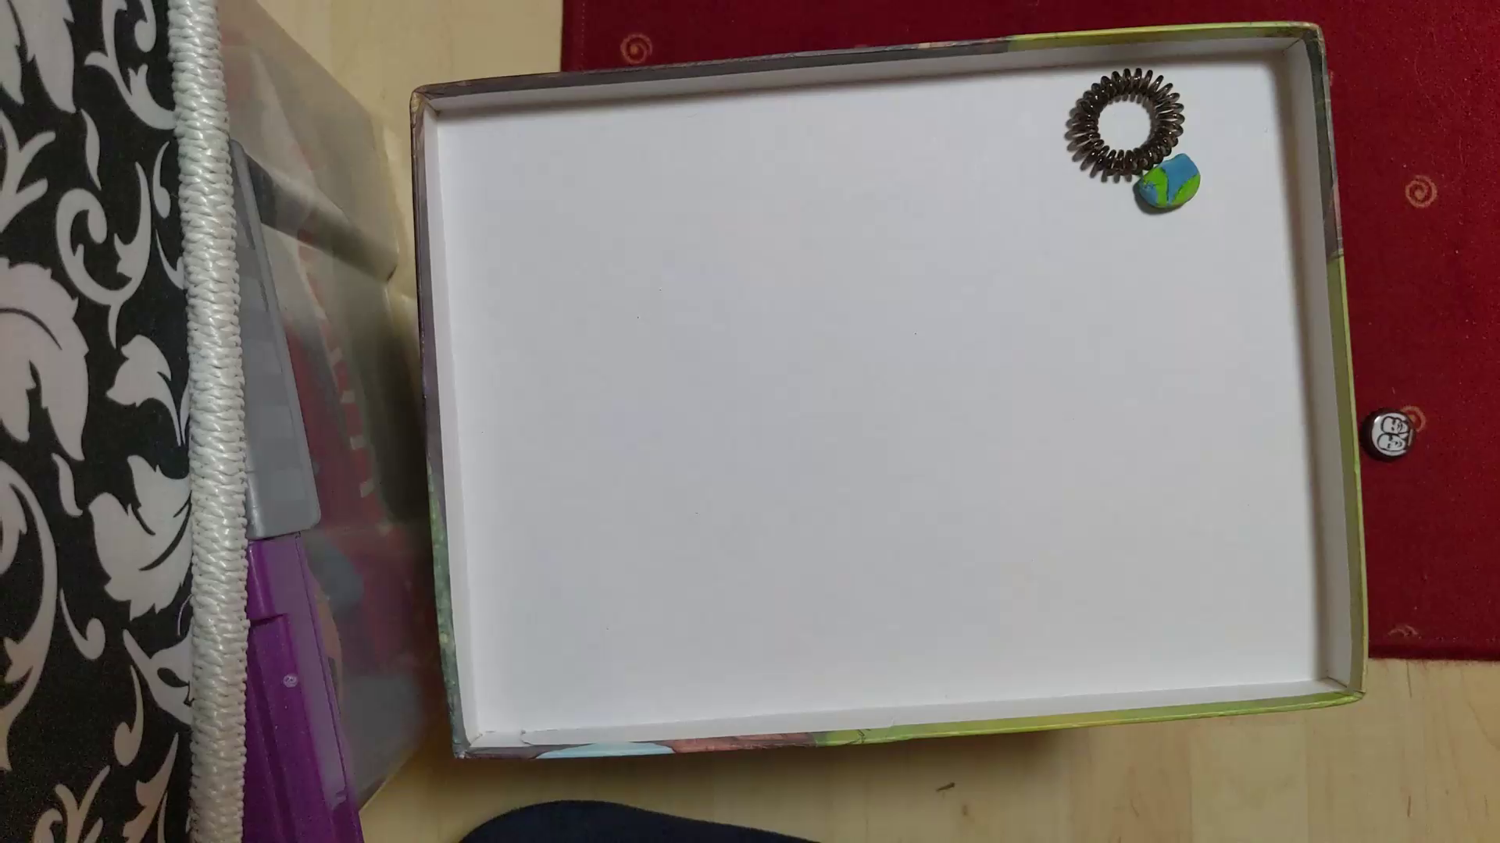
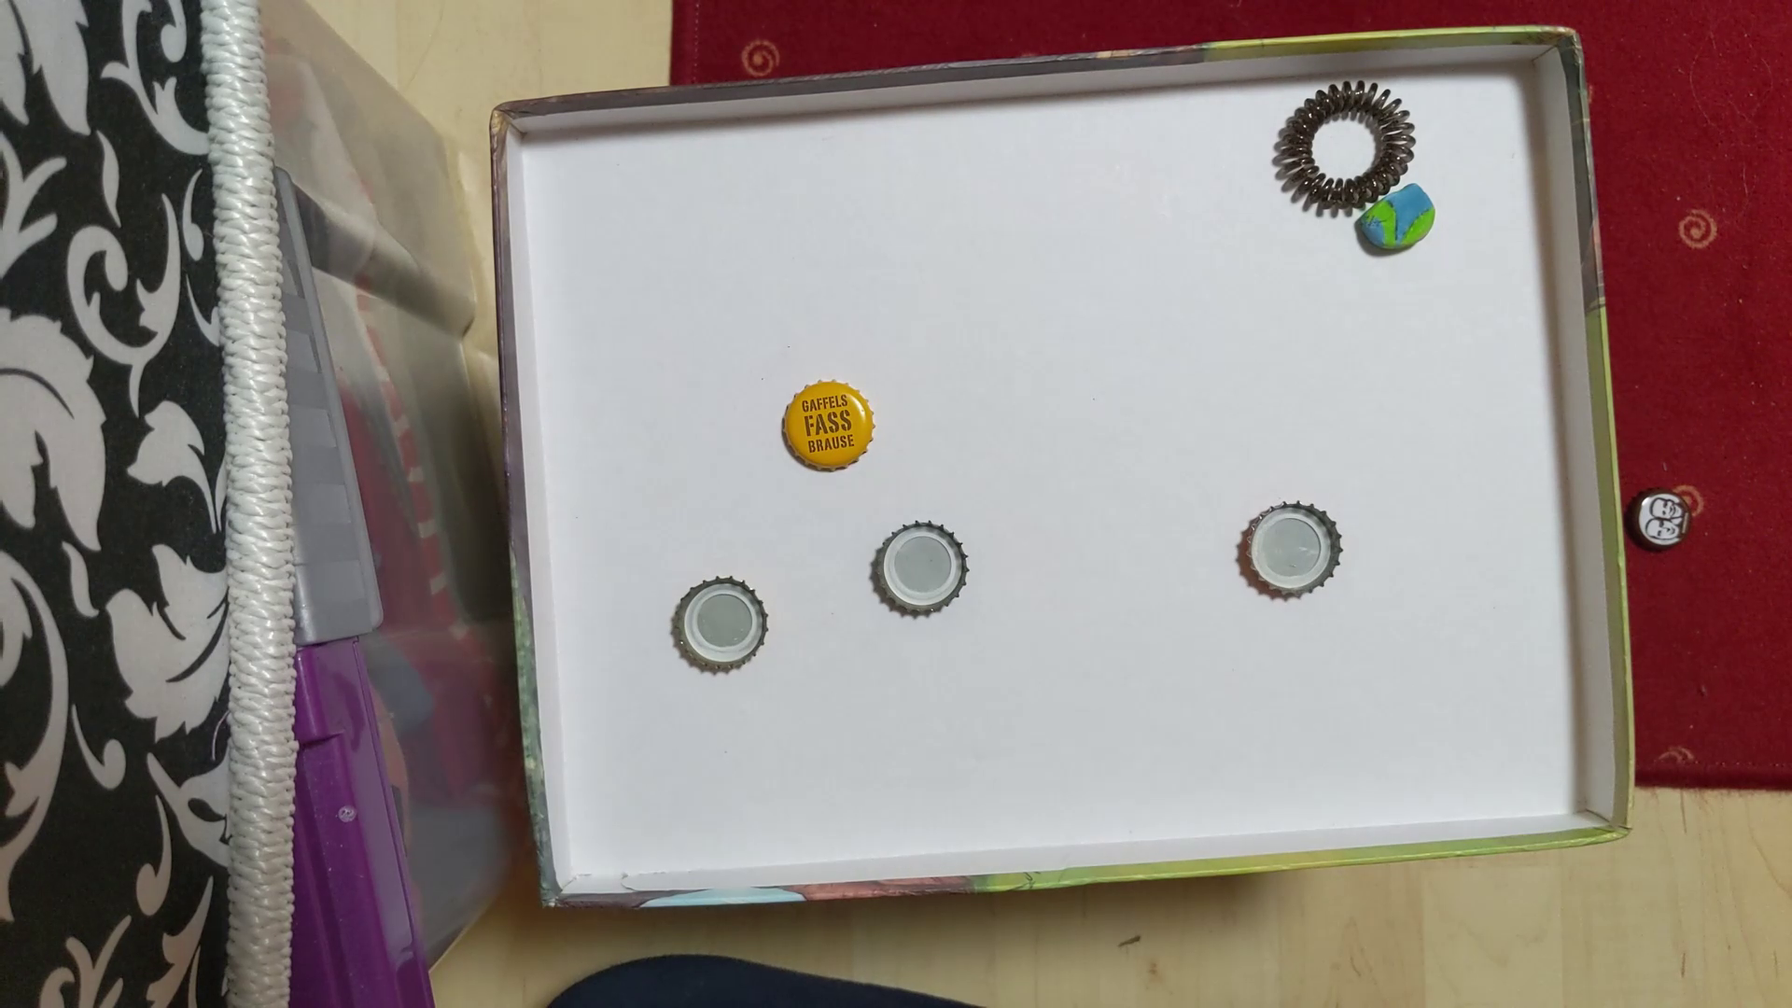
Extract Two Frames per Video
‘emptyframe’ at start of video
‘fullframe’ from choosen static scene

Slide 9
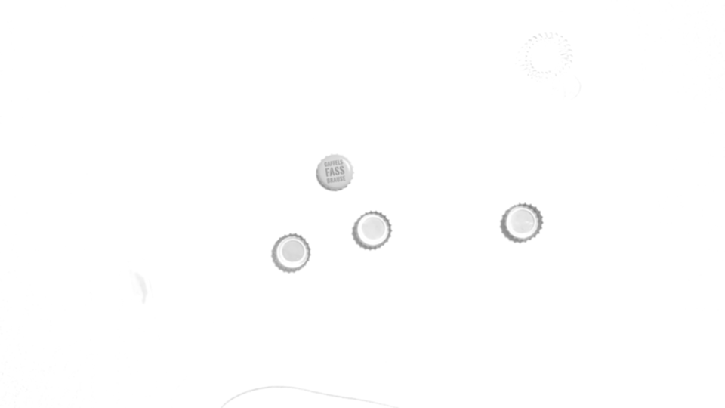
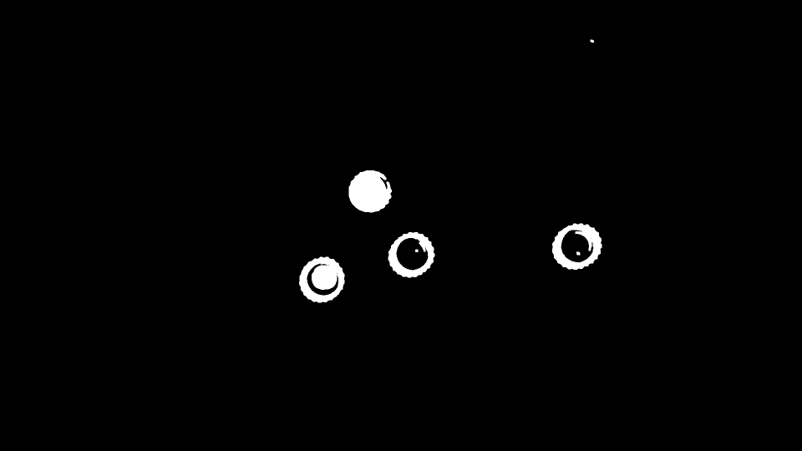
Approach - ROI
Grayscale subtraction of emptyframe and fullframe
Reduce noise with gaussian blur
Apply threshold to convert image to binary
Grow bottle cap regions
Close holes in the caps
Make the regions a little larger
Difference for Video 129
Notes:
Subtraction of the images shows regions that have changed. Those regions may contain bottle caps
White regions: regions of interest for bottlecaps

Slide 10
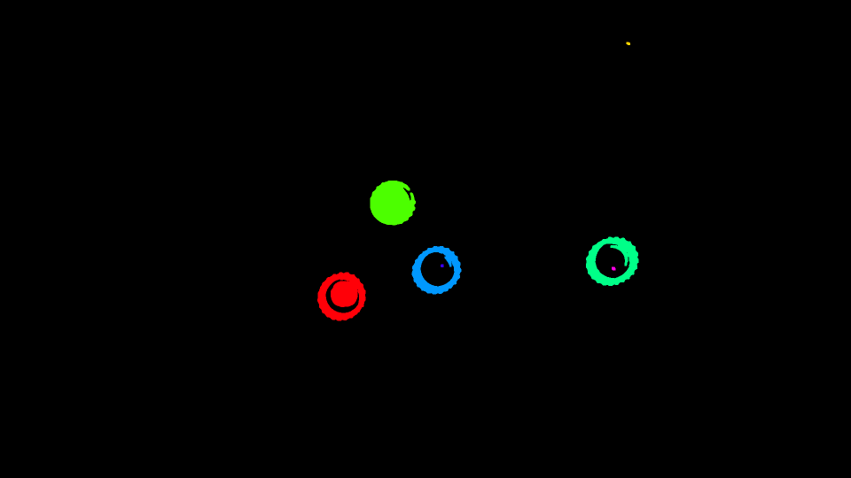
Approach - Analyze the Regions
Separate connected components
Ignore components that are very small
Define bounding box for each component
Crop out box of original rgb-fullframe
Colored connected components

Slide 11
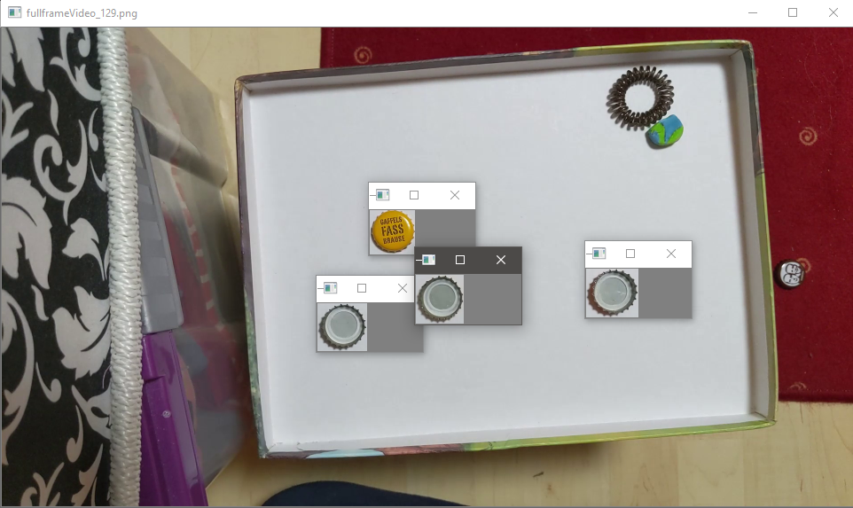
Cropped out regions placed over original image

Slide 12
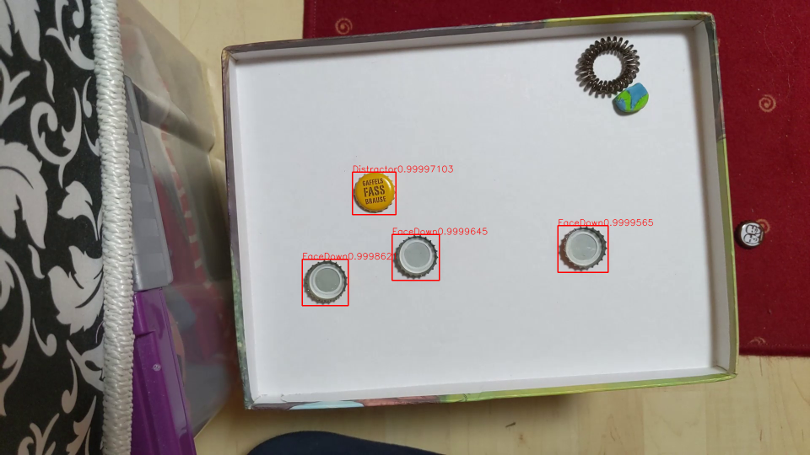
Approach – Analyze the Regions
Individual cropped regions get evaluated by a Tensorflow model
Annotated regions with tensorflow

Slide 13
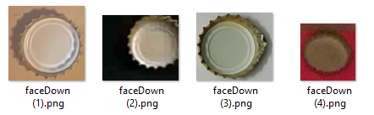
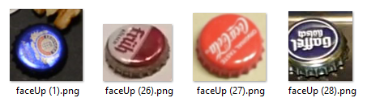
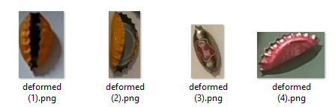
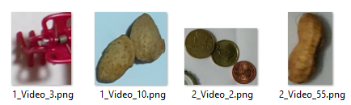
Approach - Tensorflow
Object classification with 2D convolution Layers
Trained with cropped Regions of Interests
Classes: FaceDown, FaceUp, Deformed, Distractor,
Notes:
12 Min

Slide 14
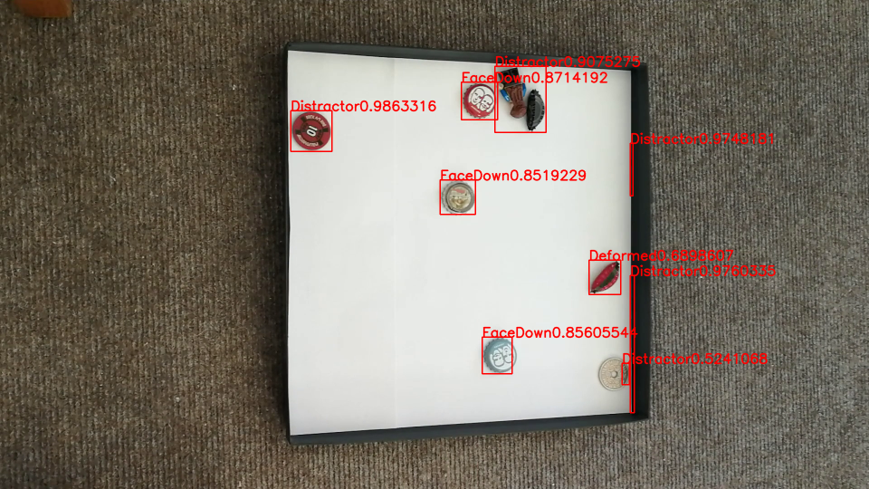
Intermediate results
Notes:
Future stepts & evaluation strategy
Discussion, riscs you might be running into, time table

Slide 15
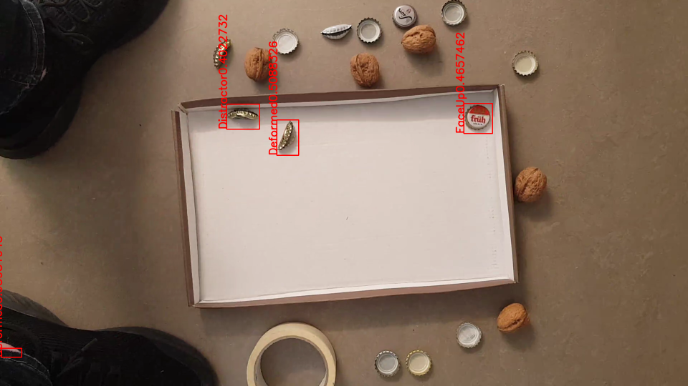
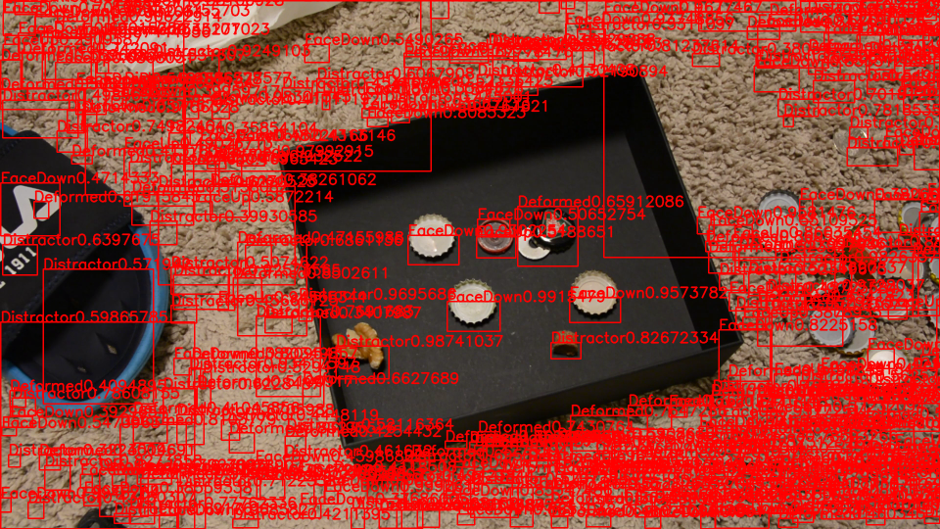
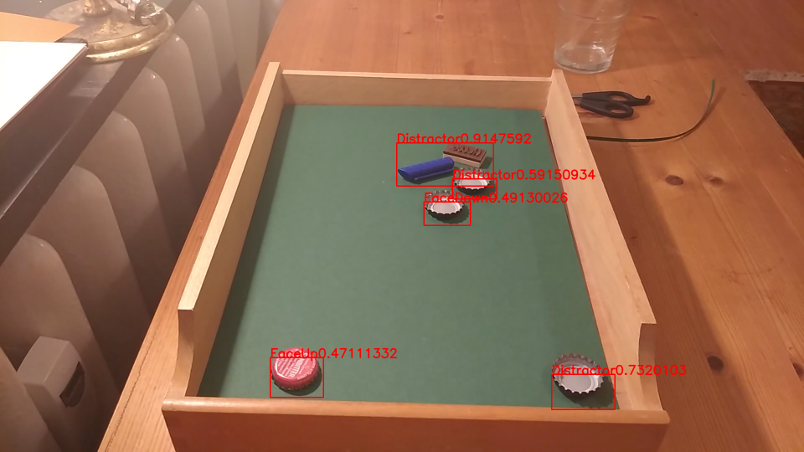
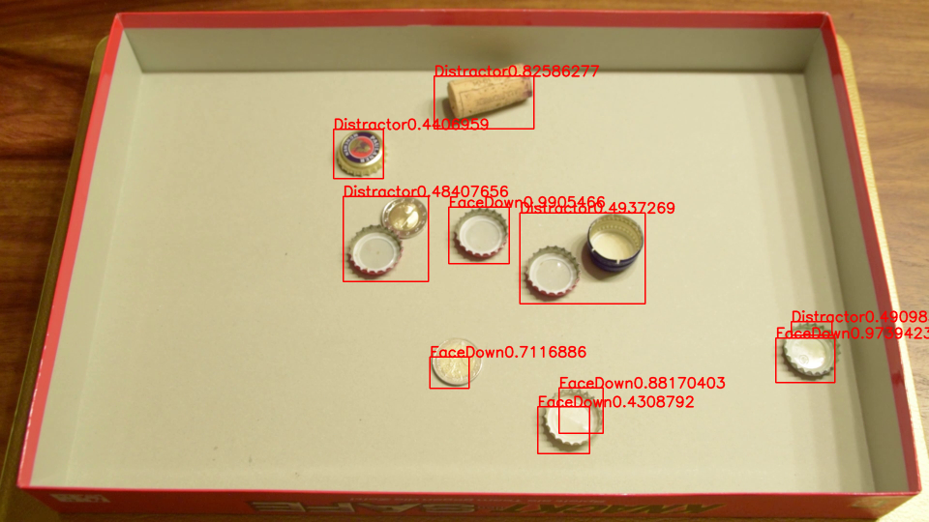
Intermediate results
Notes:
3 – 3,75 Minuten
Future stepts & evaluation strategy
Discussion, riscs you might be running into, time table

Slide 16
Intermediate results
Notes:
3 – 3,75 Minuten
Some caps

Slide 17
Intermediate results
Notes:
3 – 3,75 Minuten
Future stepts & evaluation strategy
Discussion, riscs you might be running into, time table

Slide 18
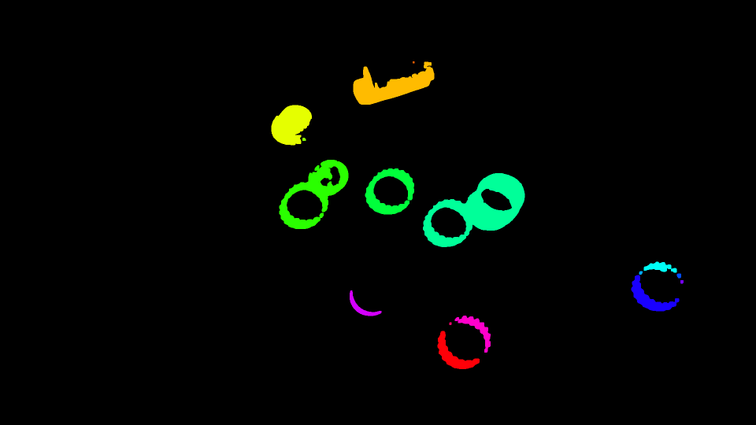
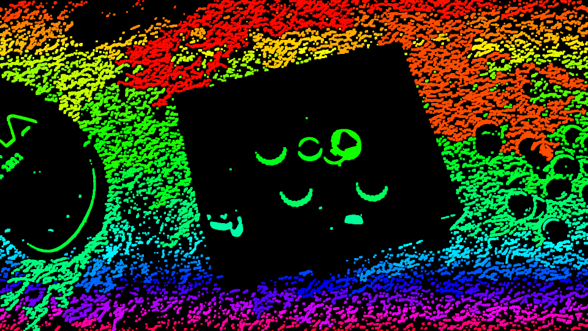
Intermediate results
Notes:
3 – 3,75 Minuten
Objects that are close together are seen as one component, one object,
Some objects are seen as two components

Slide 19
Intermediate results
Notes:
3 – 3,75 Minuten
Shaking Camera and Fluffy carpet leads to a lot of differences in the image
And outside of container

Slide 20
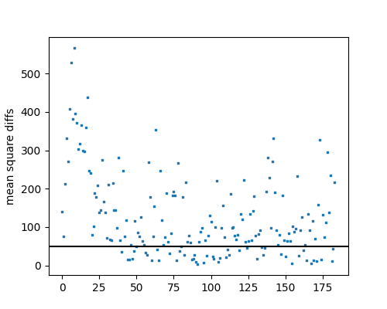
Future steps
Finding static scene in videos with a shaking camera
Isolate Container and ignore objects outside
Improve Region of Interest Detection
Improve neural network accuracy
Implement automatic evaluation
Notes:
Improving on the steps that are already in place

Slide 21
Evaluation
Use the Fotos and JSON Files from the Video-Packages for automatic evaluation
Evaluate chosen fullframe via difference to frame in Package
Compare number of regions that contain a bottle-cap to JSON
Compare how the regions are placed

Slide 22
TimeTable due dates
6.1. Improve ROI Detection and add evaluation
13.1. Isolate container and improve frame detection for busy videos
26.1. Project Report

Slide 23
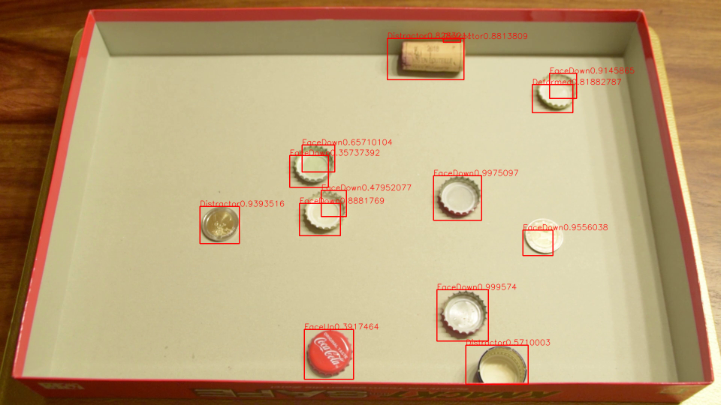
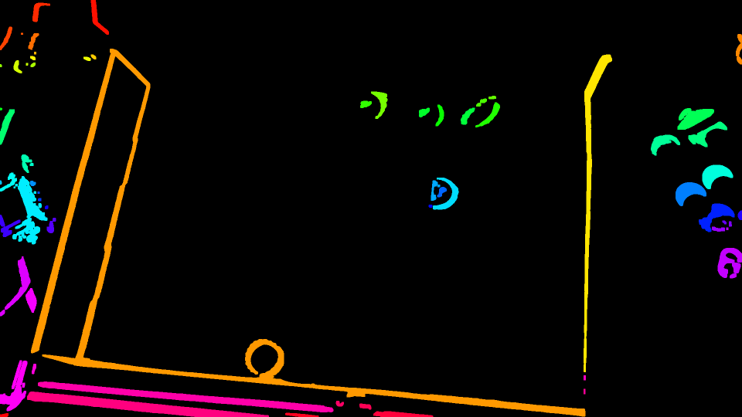
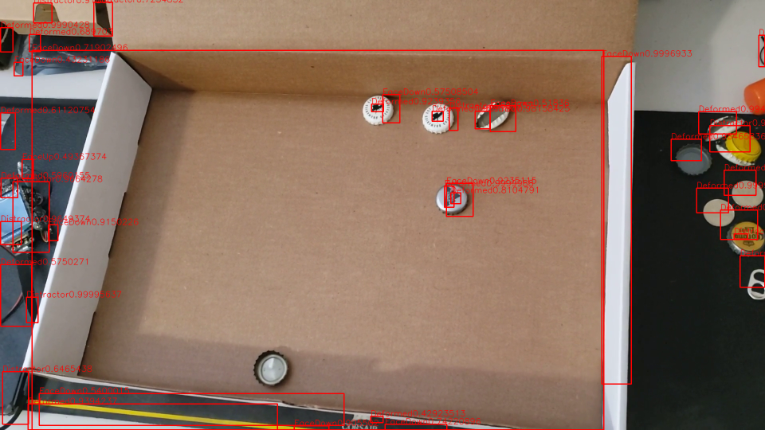
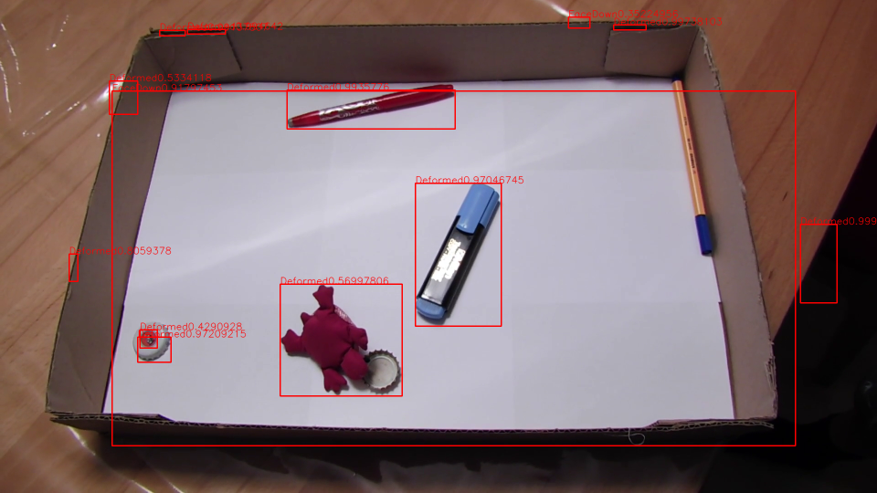
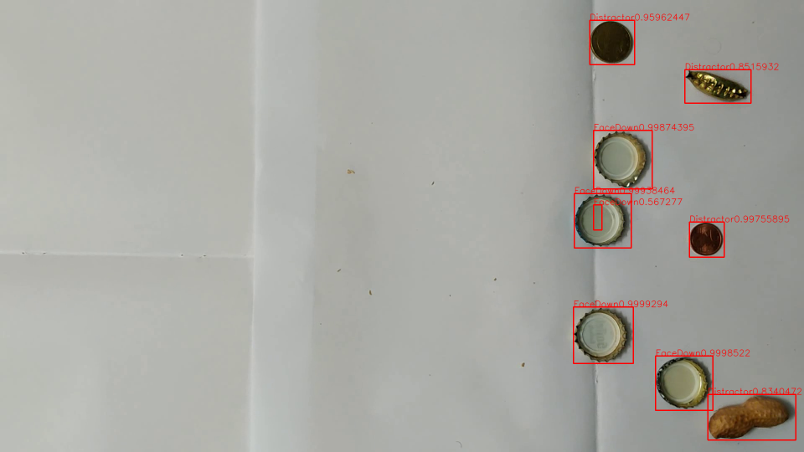
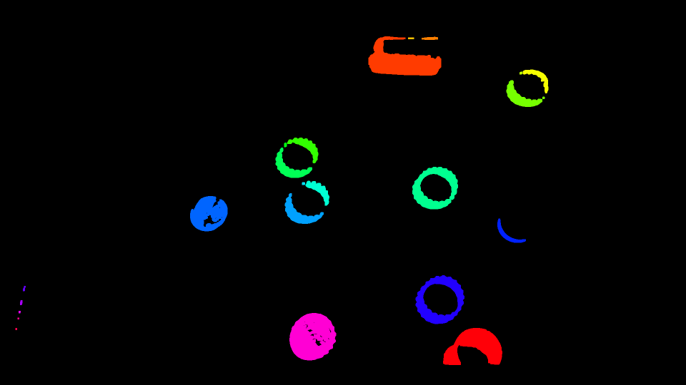
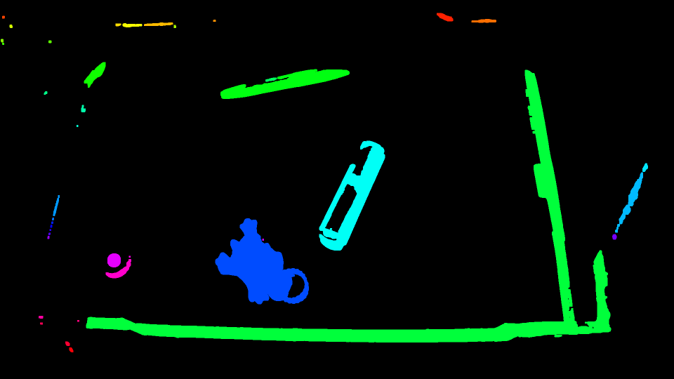
Notes:
15
Distinguishing Distractors and Deformed Caps will probably pose a challenge. As will overlapping Objects and hard shadows.
I hope you liked the presentation
Goodbey

